Slide 1

Will AI Take My Job
(Financial Advisor)
By Rahul Tailor

Slide 2
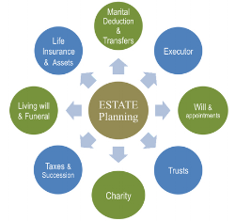


Description
A Financial Adviser is a professional who suggests and renders financial services to clients based on their financial situation. In many countries financial advisers have to complete specific training and hold a license to provide advice.
This job current still exist as in your daily life you still have to calculate expenses, income, insurance coverage, financial objectives, tax status.

Slide 3


Financial Advisor Changed in General:
Talking to clients to determine their expenses, income, insurance coverage, tax status, risk tolerance, or other information needed to develop a financial plan.
Advising strategies for clients in insurance coverage, investment planning, cash management and other areas to help them reach financial objectives.
Building and maintaining your client base.
Implementing financial plans or referring clients to professionals who can help them.

Slide 4
Financial Advisor Changed from Past to Present:
Past:
Financial markets have fully recovered from the crash of 2008, and financial advisor productivity is at an all-time high.
Demand for investment advice is strong and growing.
Investors who already work with a financial advisor are for the most part very satisfied.
Advisors have embraced a team approach to serving clients, enabling them to offer more sophisticated planning and investment management to a broader array of investors.
Present:
Money, changes from one broker-dealer to another rewards the advisor with an up-front bonus
Having control over more business and leading them into a good environment.

Slide 5

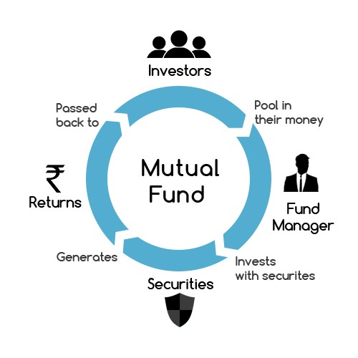
Education Needed require for the job:
Bachelor degree in Business, Finance or related field.
1-2 years of sales experience.
Must have current FINRA Series 7 and 63 Securities Registration (66 or 65 preferred).
Life and health license.
Valid driver’s license.
Knowledge of mutual fund, securities, and insurance industries.
Proficient in Word, Excel, Outlook, and PowerPoint.
Comfortable using a computer for various tasks.
Experience providing quality financial advice.

Slide 6
Thanks for listening

